Slide 1
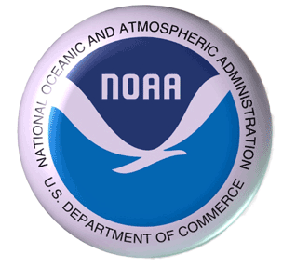
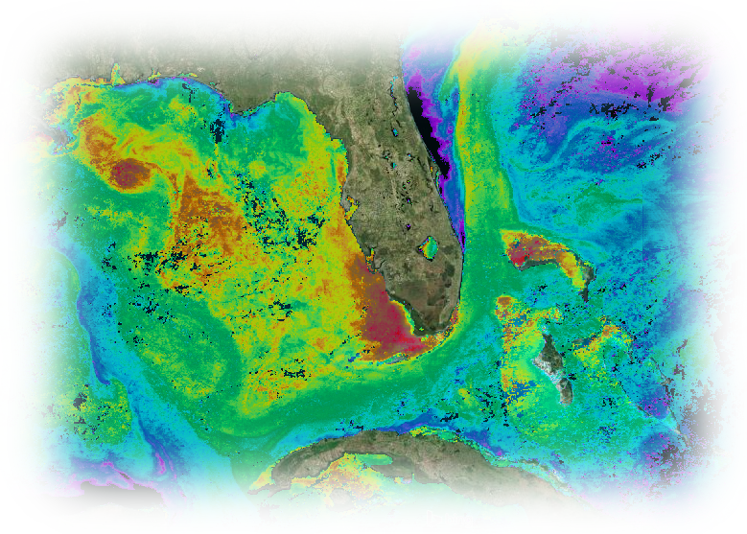

Observational requirements for variables related to human health and safety
Joaquin.Trinanes@noaa.gov CGoM CW & AOW Op. Manager

Slide 2
CoastWatch/OceanWatch
Provide integrated data and tools to scientists and other stakeholders to better understand the physical, biological, and chemical ocean processes.
Scientific quality products and near-real time datasets needed to support climate, ocean, ecosystems, and weather studies.
Tools developed and implemented to deliver interoperable products through a service-oriented architecture, using international recognized standards for data and metadata.
Both CoastWatch and OceanWatch efforts run in parallel, with the latter focusing on a larger region of interest, primarily the Atlantic basin and global oceans.

Slide 3
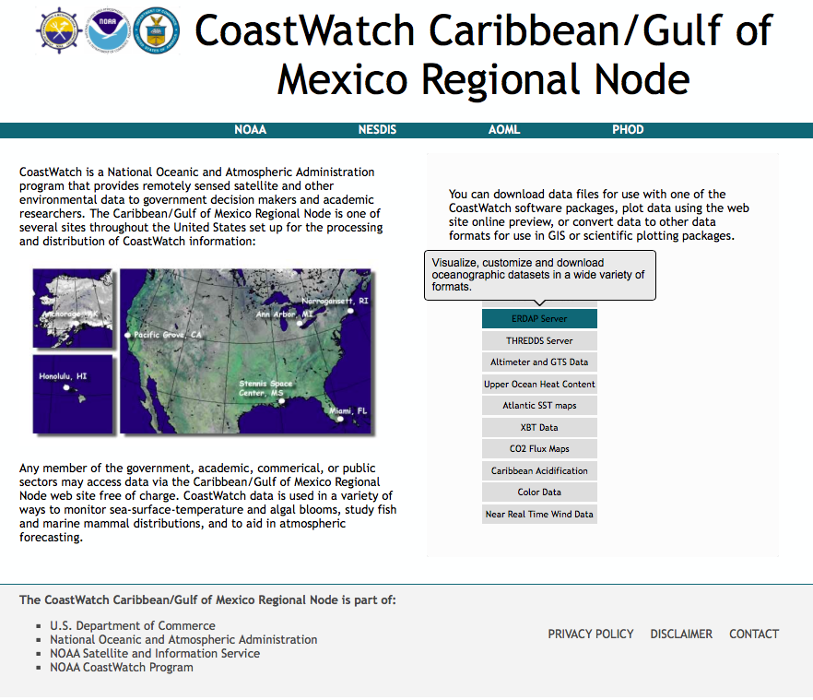
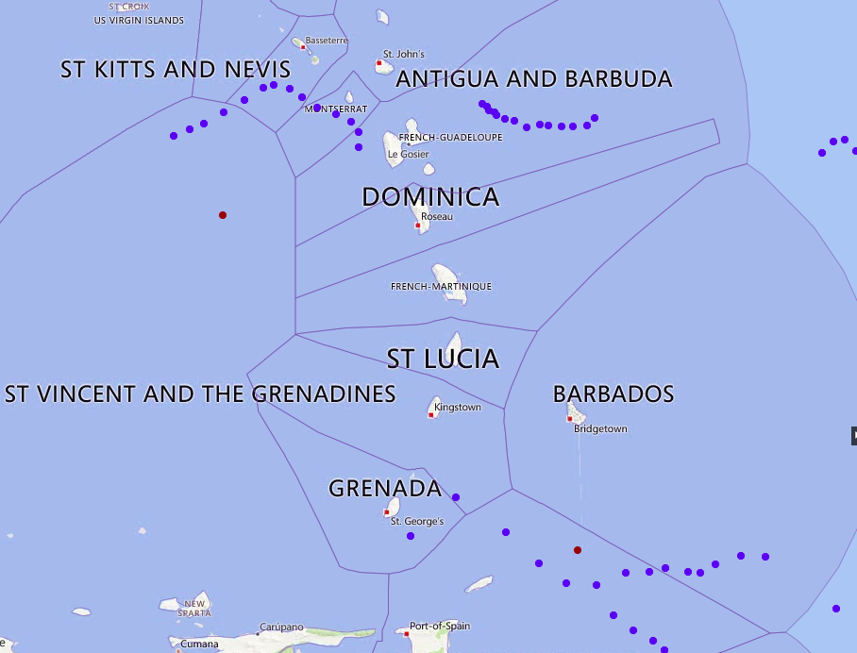
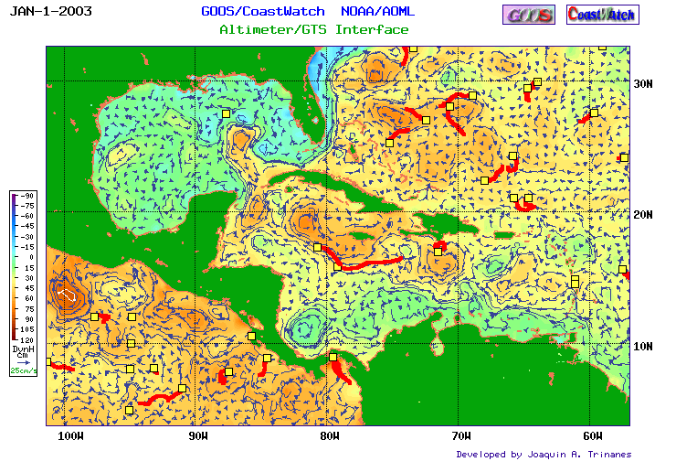
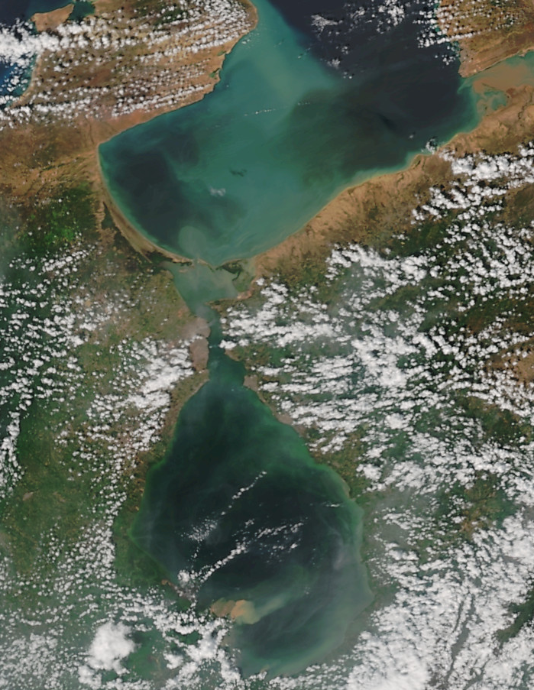
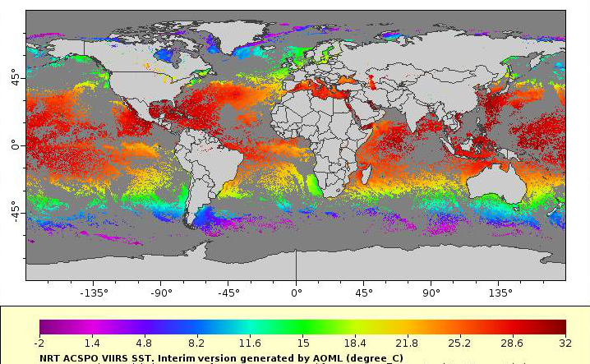
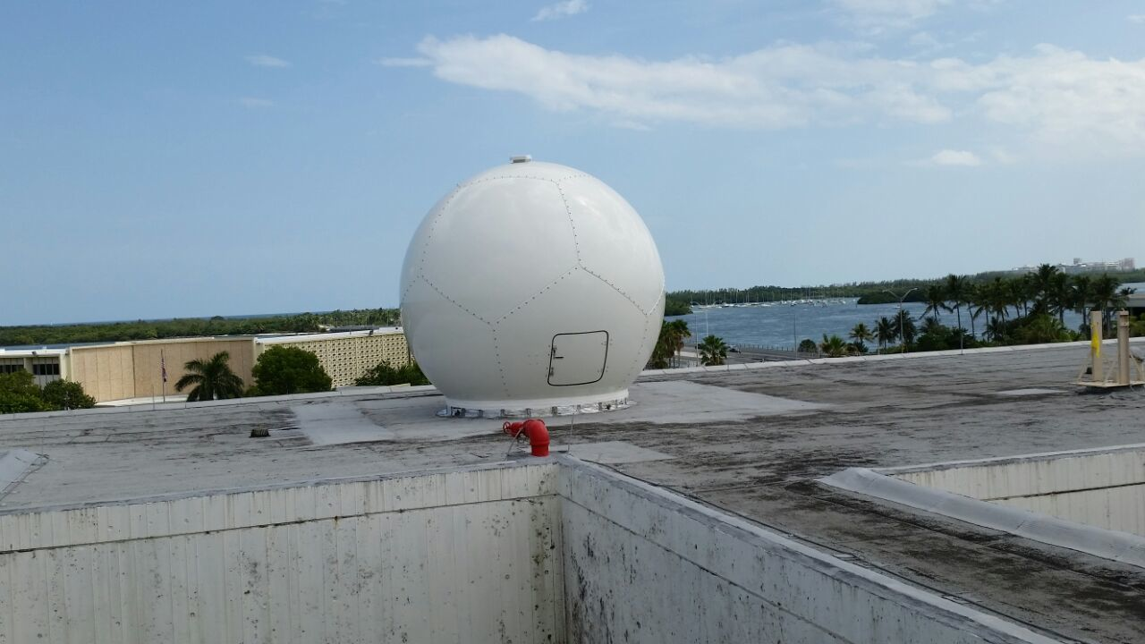
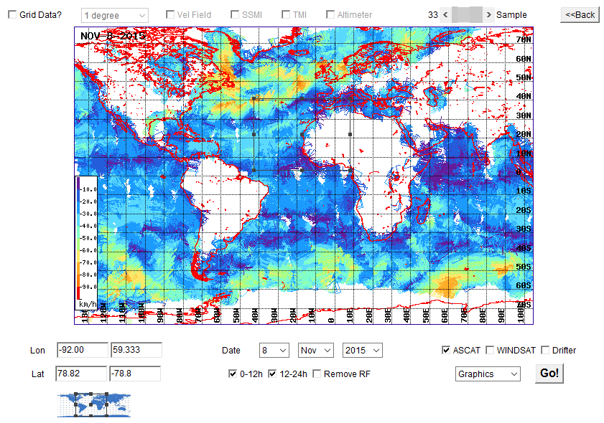
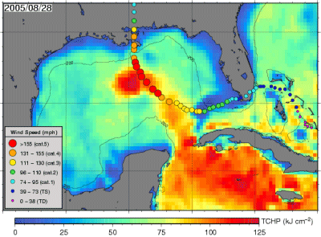
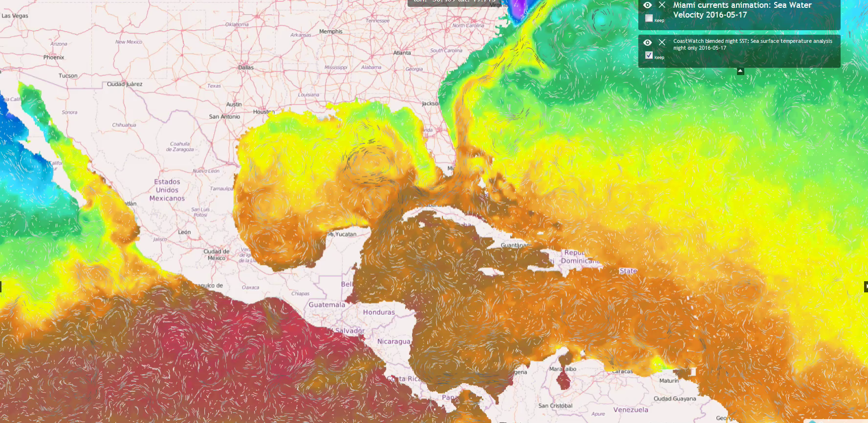
CW/OW: Products

Slide 4
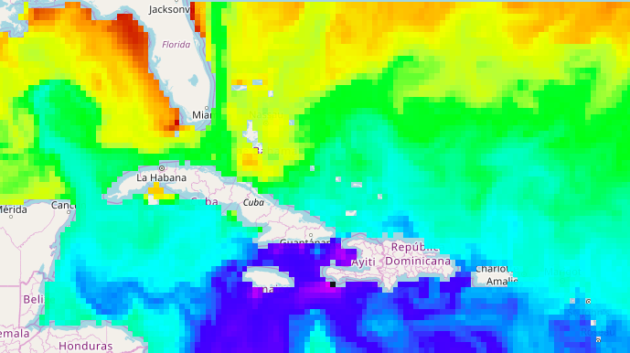
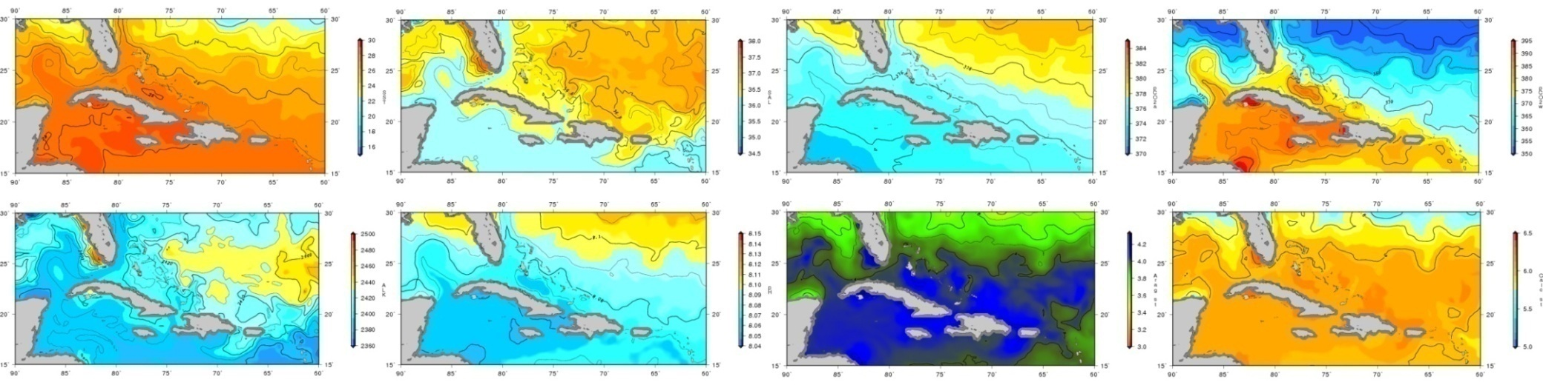
Ocean Acidification (R. Wanninkhof)
2018-01-16 pH
Notes:
SSS, SST, pCO2w,Total alkalinity, Aragonite saturation state, inorganic carbon, bicarbonate Ion concentration, pH, …

Slide 5

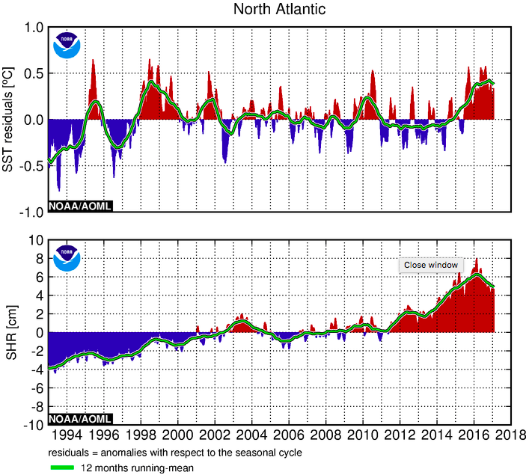
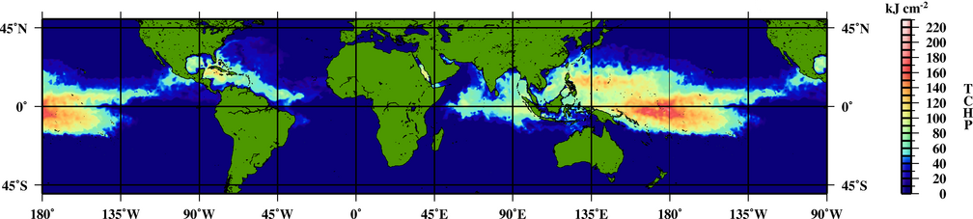
Tropical Cyclone Heat Potential
(G. Goni)

Slide 6
Vibrio
Cholera:The World Health Organization (WHO) estimates that the amount of cases reported each year represents just 5-10% of the number of actual cases due to poor surveillance systems. There are an estimated 11 million cases each year, excluding outbreaks.
Vparahae&Vulnificus: These species do not cause cholera but can cause illness when consumed from contaminated seafood. Although illness caused by V. vulnificus is less common than other Vibrio species, the mortality rate is very high and it is the leading cause of death related to seafood.
Incidence There is an estimated 4,500 cases of food-borne illness caused by V. paraheamolyticus each year in the US; outbreaks are more common in warmer months. There are an estimated 96 cases of food-borne illness caused by V. vulnificus each year in the US.

Slide 7
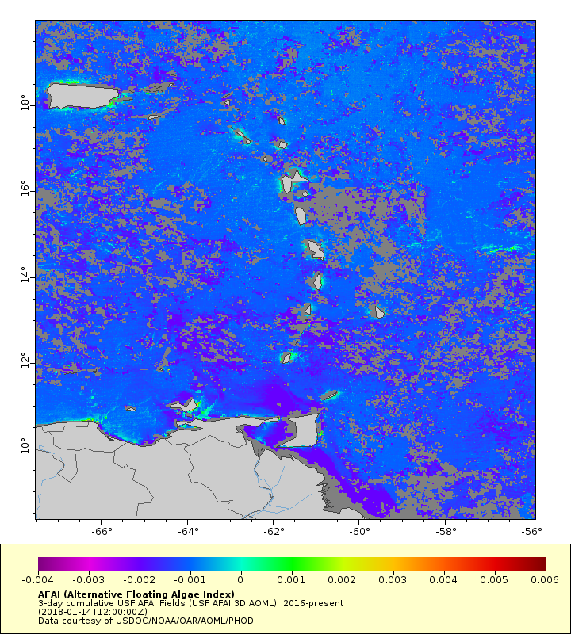
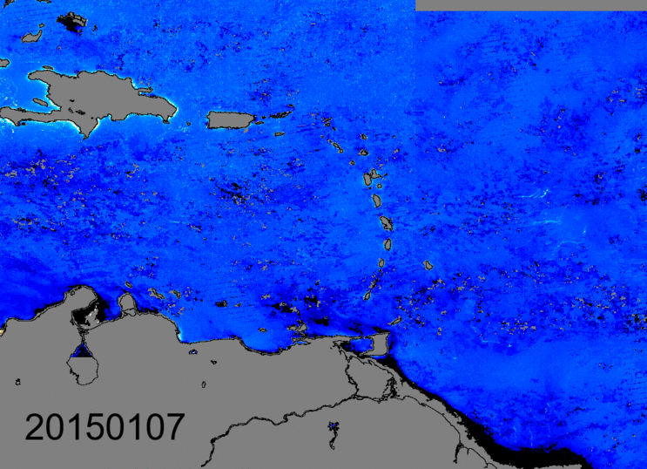
Sargassum (AFAI)
(Chuanmin Hu, USF)
Ongoing: MCI from S-3A
Notes:
Economic, environmental and health impacts: the rotting of sargassum releases hydrogen sulfide and also sargassum easily collects heavy metals, pesticides, etc.

Slide 8
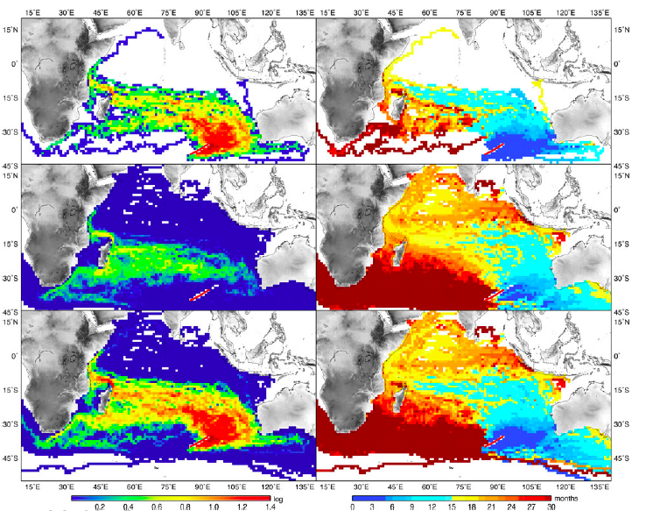
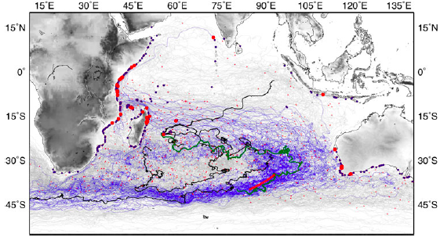
Ocean Debris Tracking
Methodology published in JOO (Trinanes et al, Analysis of flight MH370 potential debris trajectories using ocean observations and numerical model results)
Transition to products and applications

Slide 9
Ocean Debris Tracking

Slide 10
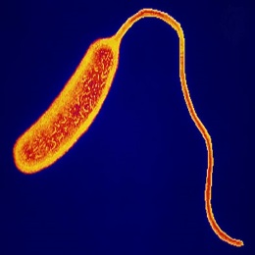
Vibrio Facts
Pathogenic vibrios present in marine environment
Proliferate in warm and low salinity seawater
Clinical manifestations: Wound infections, gastroenteritis, septicaemia (100 fatalities /year USA)
Cholera: ~11 million cases/year (5-10% of the number of actual cases due to poor surveillance systems)
Other factors: ageing population, shellfish consumption, contact with water, etc.
Can RS help to track Vibrio disease emergence?
Open questions: Can pathogenic Vibrios move with currents?
Regional & Global models?
Notes:
1. Wound infections. Caused by a range of different Vibrio spp. including V. vulnificus, V. alginolyticus, V. cholerae – normally caused by exposure of cut, wound or abrasion to contaminated seawater. Seriousness of infection is partly determined by species in question – V. vulnificus probably the worst ~25% mortality rate (Oliver 2005).
Gastroenteritis. Nausea, vomiting, diarrhoea - again, caused by a range of different Vibrio spp. – most commonly V. vulnificus, V. parahaemolyticus and V. cholerae – normally caused by consumption of raw/undercooked seafood and/or exposure to contaminated water sources.
3. Septicaemia (blood poisoning). Most serious clinical manifestation associated with vibriosis. Often fatal, depending on pathogen involved (V. vulnificus > 50% of cases). 100 Vibrio fatalities a year in the USA, mostly septicaemia-associated, numerous recent cases in Europe.

Slide 11
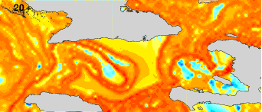
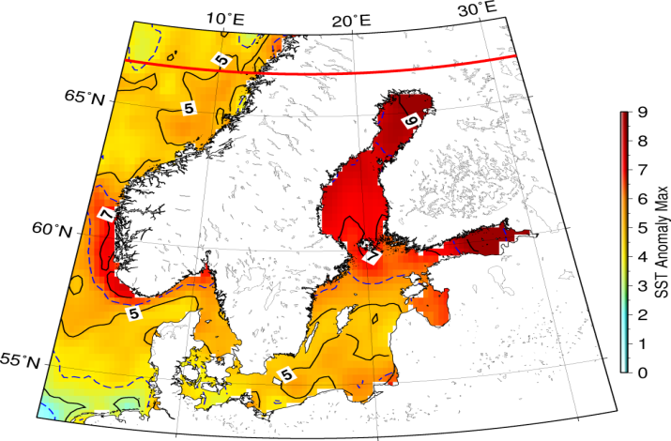
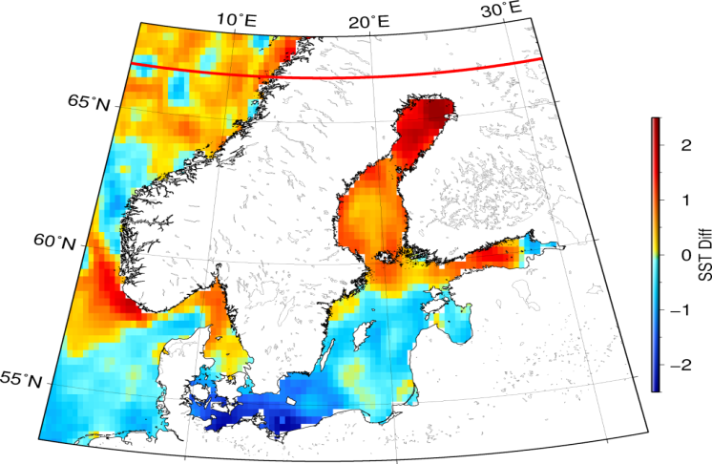
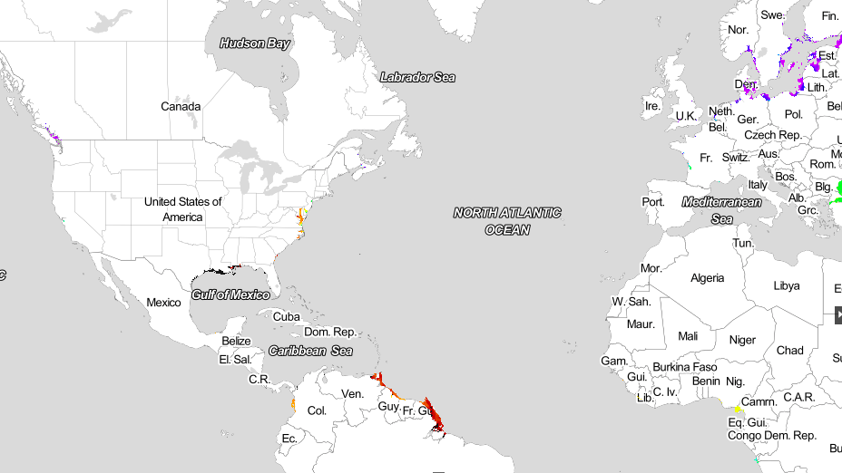
Vibrio
Collaboration: NOAA, CEFAS, FDA and USC
A
B
Notes:
"the plausibility of an effective flow of water connecting both sides of the strait which may imply a transport of planktonic organisms and associated bacteria, including pathogenic Vibrio"

Slide 12
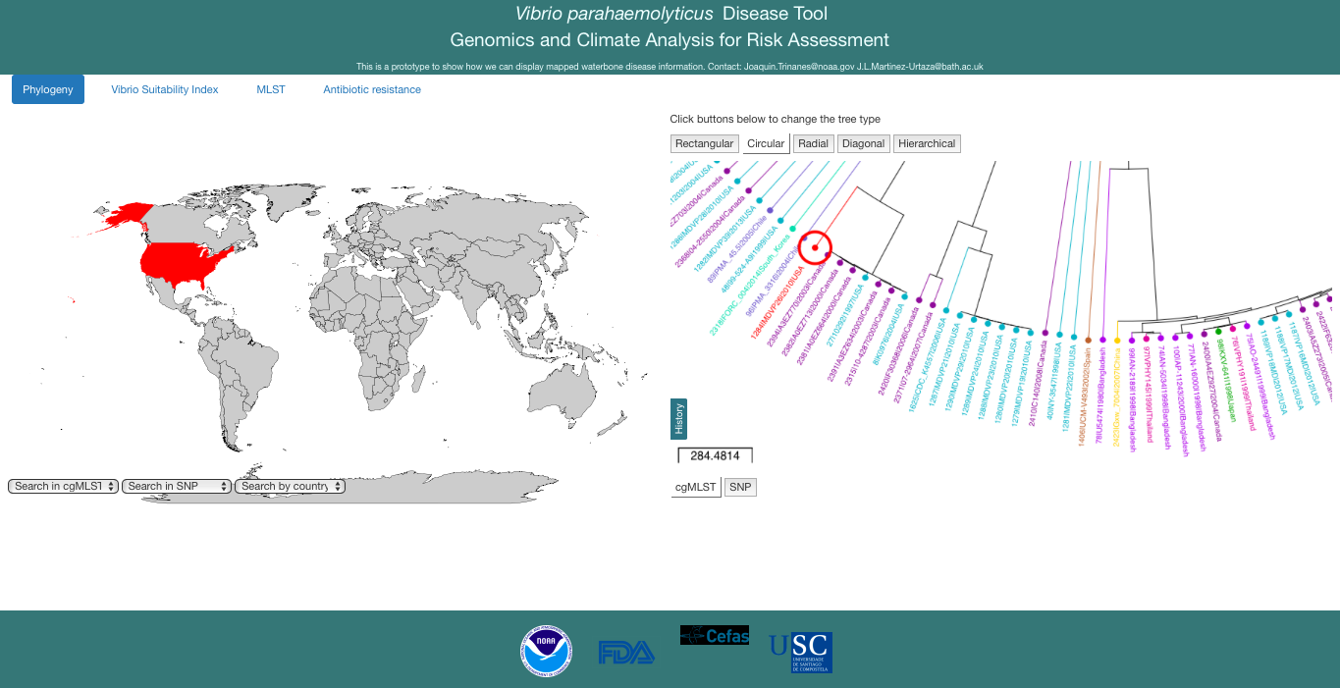
Vibrio Phylogeography

Slide 13
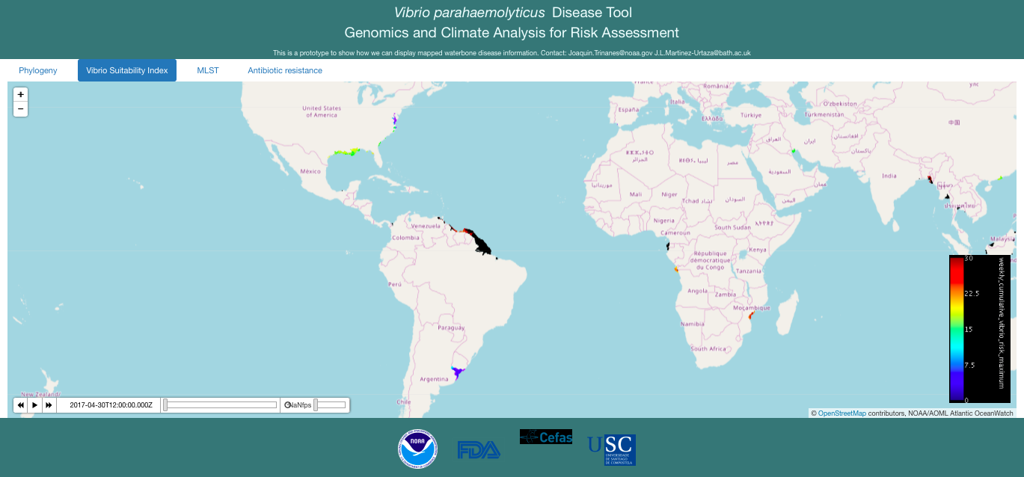
Suitability Index

Slide 14
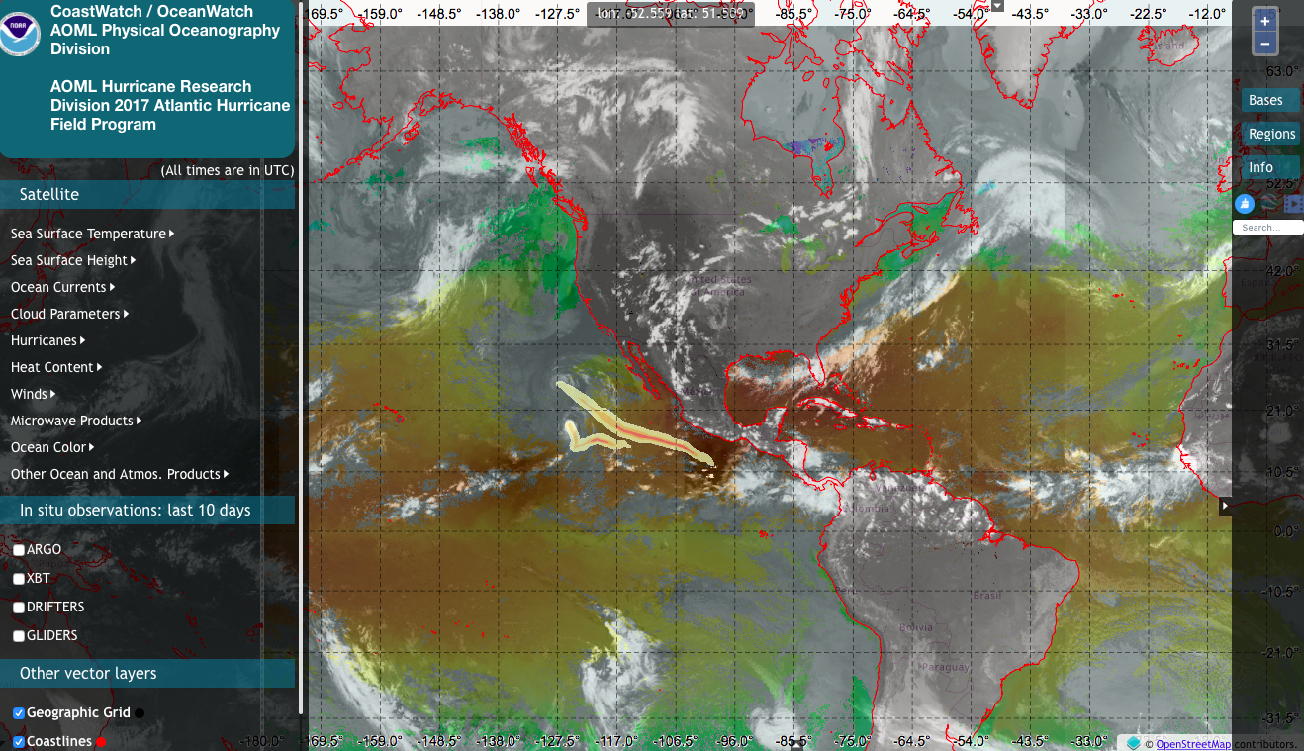
Ocean Viewer

Slide 15
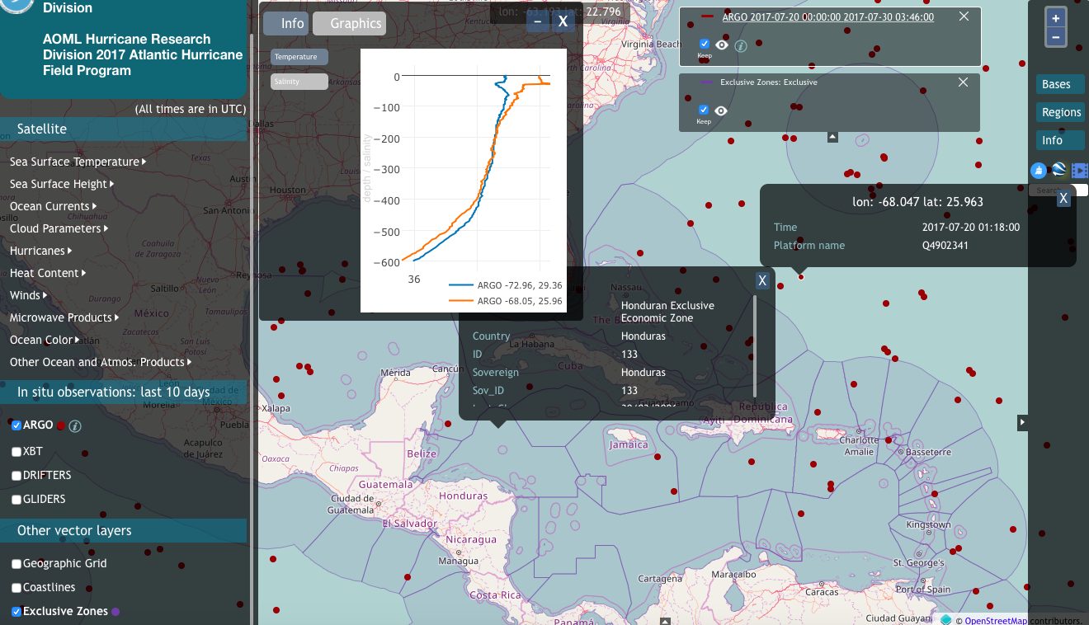
Ocean Viewer

Slide 16
Conclusions
NOAA goals (and GEOSS) support the sharing of free, accessible, sustained, interoperable and user-friendly environmental data and metadata.
Needed for informed public-health decision making and the development of appropriate tools.
Integration and coordination is a must (environment, epidemiological, socio-economic, …), as well as the development of best practices and common formats.
Work on Vibrio shows what can be done for other species
Notes:
1. Wound infections. Caused by a range of different Vibrio spp. including V. vulnificus, V. alginolyticus, V. cholerae – normally caused by exposure of cut, wound or abrasion to contaminated seawater. Seriousness of infection is partly determined by species in question – V. vulnificus probably the worst ~25% mortality rate (Oliver 2005).
Gastroenteritis. Nausea, vomiting, diarrhoea - again, caused by a range of different Vibrio spp. – most commonly V. vulnificus, V. parahaemolyticus and V. cholerae – normally caused by consumption of raw/undercooked seafood and/or exposure to contaminated water sources.
3. Septicaemia (blood poisoning). Most serious clinical manifestation associated with vibriosis. Often fatal, depending on pathogen involved (V. vulnificus > 50% of cases). 100 Vibrio fatalities a year in the USA, mostly septicaemia-associated, numerous recent cases in Europe.

Slide 17
Key Questions
Improve monitoring and surveillance systems that allow for the sharing of data
Where are we likely to see these important pathogens emerge in the future, in the context of a warming climate system?
How can we accurately attribute changing environmental factors and reliably demarcate the role that this plays in increasing clinical risk?
Notes:
1. Wound infections. Caused by a range of different Vibrio spp. including V. vulnificus, V. alginolyticus, V. cholerae – normally caused by exposure of cut, wound or abrasion to contaminated seawater. Seriousness of infection is partly determined by species in question – V. vulnificus probably the worst ~25% mortality rate (Oliver 2005).
Gastroenteritis. Nausea, vomiting, diarrhoea - again, caused by a range of different Vibrio spp. – most commonly V. vulnificus, V. parahaemolyticus and V. cholerae – normally caused by consumption of raw/undercooked seafood and/or exposure to contaminated water sources.
3. Septicaemia (blood poisoning). Most serious clinical manifestation associated with vibriosis. Often fatal, depending on pathogen involved (V. vulnificus > 50% of cases). 100 Vibrio fatalities a year in the USA, mostly septicaemia-associated, numerous recent cases in Europe.

Slide 18
Key Questions
How can we provide a framework for sharing data between different stakeholders (e.g., clinicians, scientists, microbiologists, risk assessors, etc.) with regard to these important emerging pathogens?
How can the next-generation sequencing data being produced at the moment be used most appropriately in outbreak investigations and for understanding the emergence of these pathogens?
How important is remote-sensing-based analyses in understanding the environmental conditions prior to, during, and after Vibrio (or norovirus,…) outbreaks?
Notes:
1. Wound infections. Caused by a range of different Vibrio spp. including V. vulnificus, V. alginolyticus, V. cholerae – normally caused by exposure of cut, wound or abrasion to contaminated seawater. Seriousness of infection is partly determined by species in question – V. vulnificus probably the worst ~25% mortality rate (Oliver 2005).
Gastroenteritis. Nausea, vomiting, diarrhoea - again, caused by a range of different Vibrio spp. – most commonly V. vulnificus, V. parahaemolyticus and V. cholerae – normally caused by consumption of raw/undercooked seafood and/or exposure to contaminated water sources.
3. Septicaemia (blood poisoning). Most serious clinical manifestation associated with vibriosis. Often fatal, depending on pathogen involved (V. vulnificus > 50% of cases). 100 Vibrio fatalities a year in the USA, mostly septicaemia-associated, numerous recent cases in Europe.

Slide 19
Thank you!
Joaquin.Trinanes@noaa.gov

