Slide 1
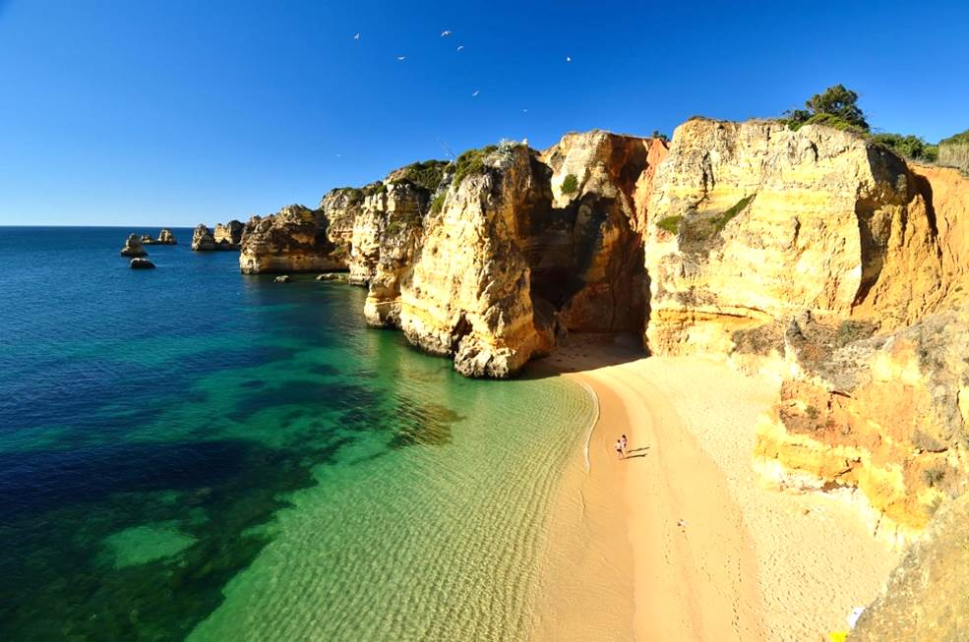
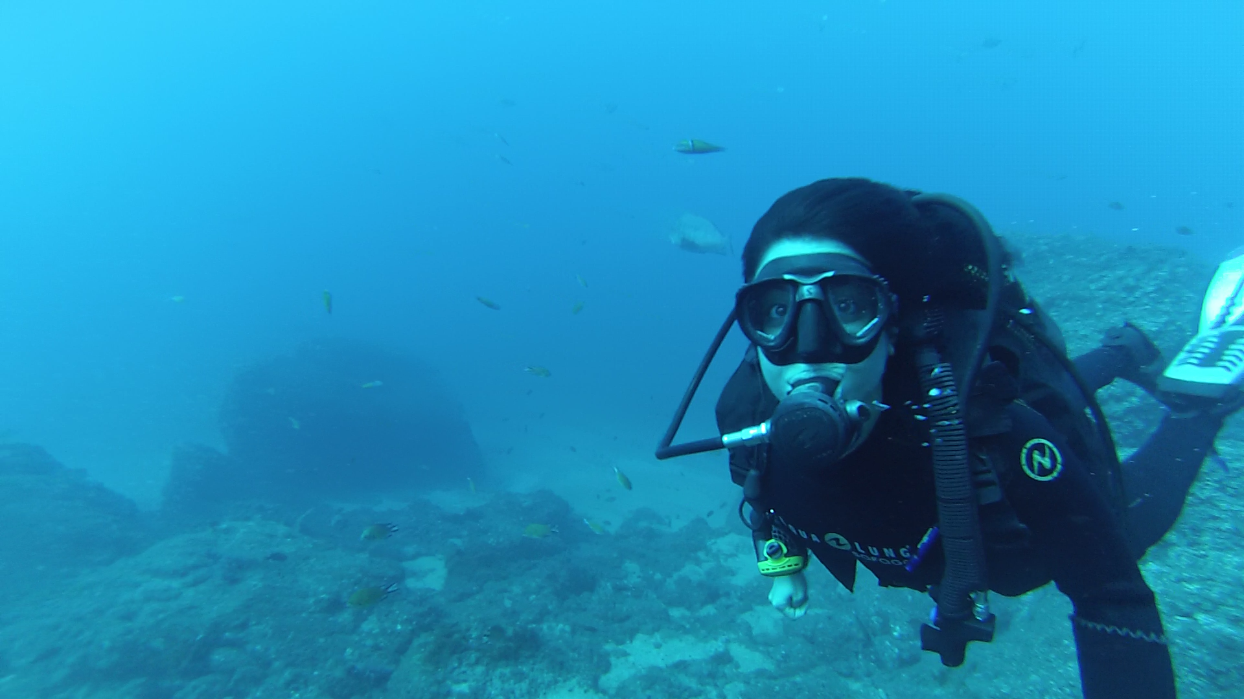

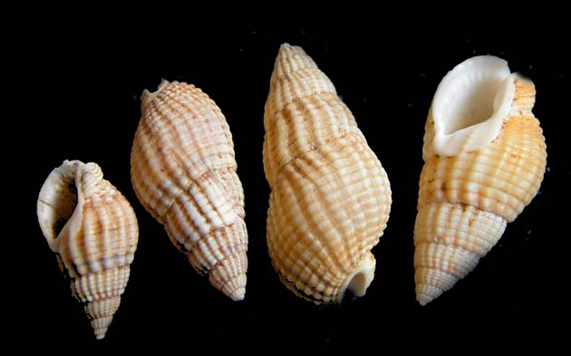
Who am I? Joana Mira Veiga
Marine Biology
Impacts of marine pollution - imposex

Slide 2
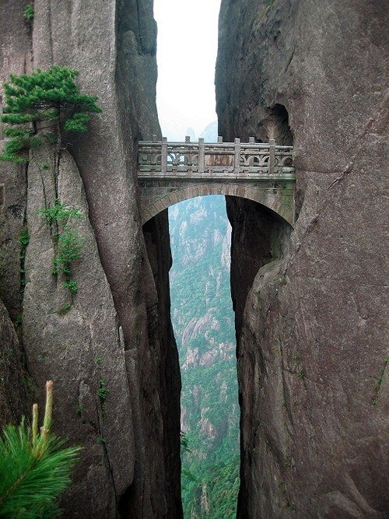


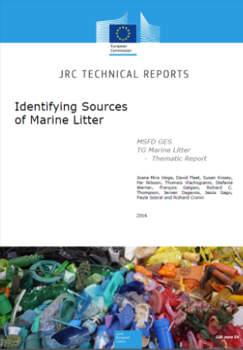

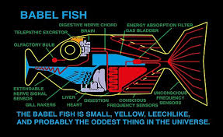
What are my areas of interest ?
Science-policy interface Toward solutions…

Slide 3
My expectations concerning the workshop and the outcomes
- Ambition: Outcome that is meaningful for policy and supports transition to solutions - Contribution: holistic view, support the integration with other domains - Network: Broad (mainly EU) network from academia, NGOs, industry, waste management, EU agencies (eg EEA), Regional Seas (e.g. UNEP-MAP )

