Slide 1
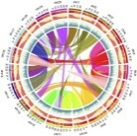
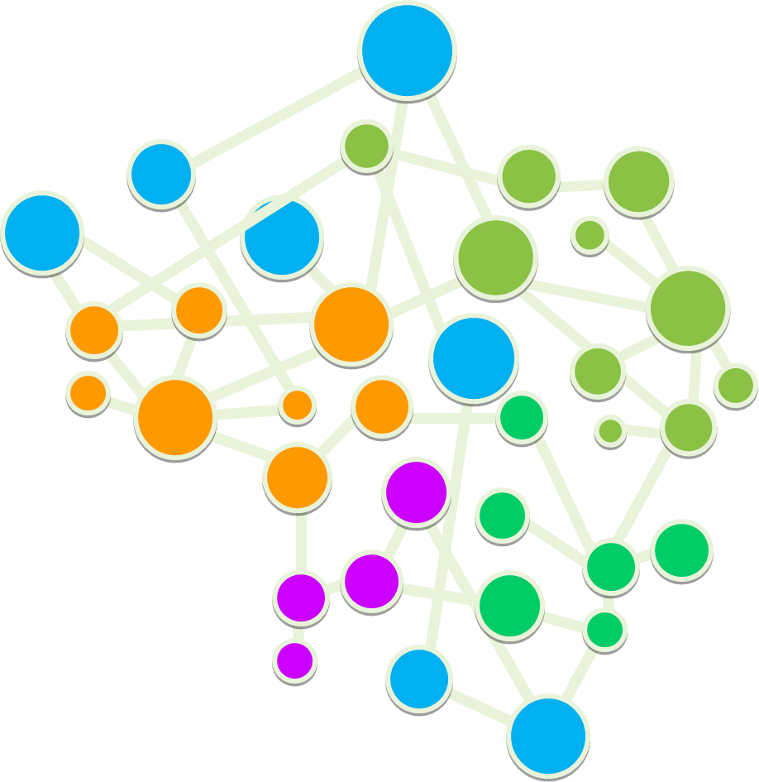
Who am I ?
?
Marine Debris Indicators: What’s Next? 16-18 December 2019 Brest

Slide 2
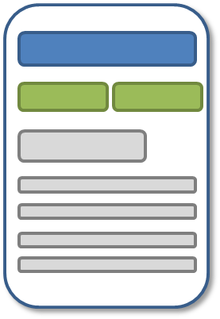
What are my areas of interest ?
Knowledge Representation, Semantic Technologies, Ontology

Slide 3
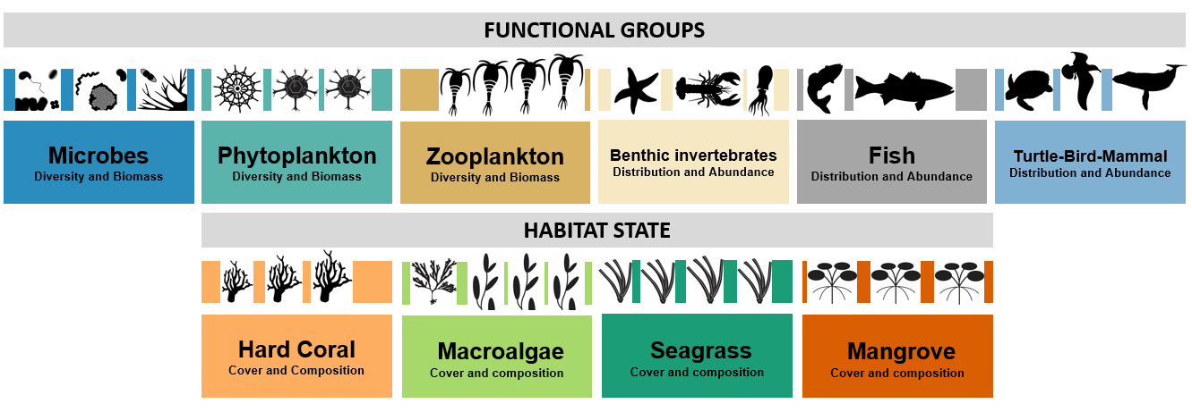
What are my areas of interest ?
Multi-omics / eDNA /
Bioinformatics

Slide 4
My expectations concerning the workshop and the outcomes
Ambition - Align, resonate, amplify data science for debris & the SDGs
Ideas - Pathway to stabilise & link knowledge and data
Your contributions - Technologies, Best Practices, networks of networks
Networks
(selected)

