Slide 1

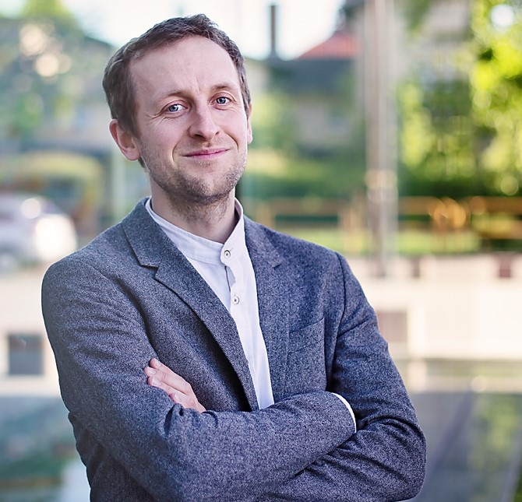


Artur Palacz
IOCCP/GOOS Biogeochemistry Panel Project Officer
Assistant Professor at IOPAN (Poland)

Slide 2
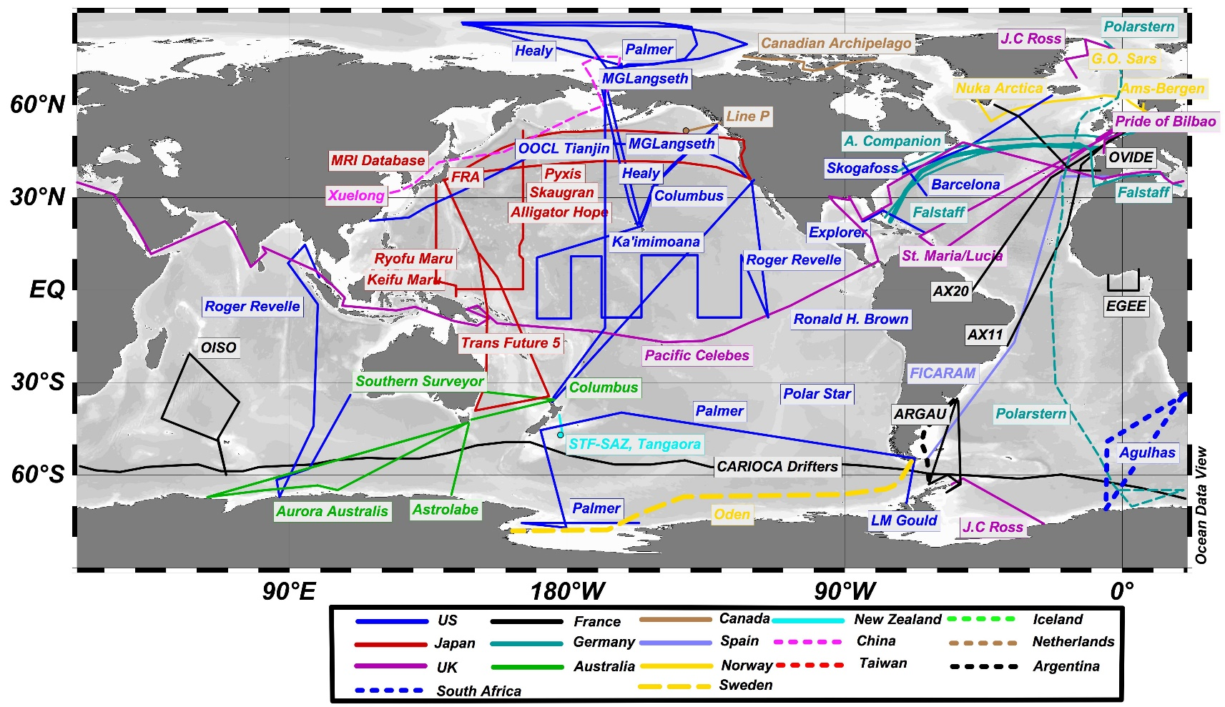

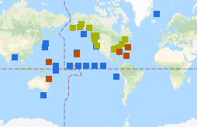
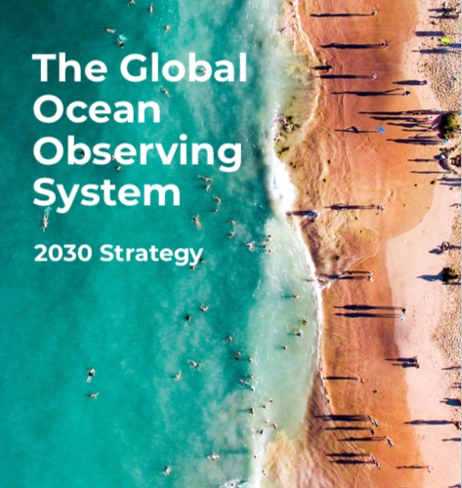
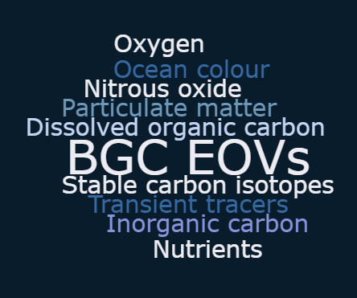
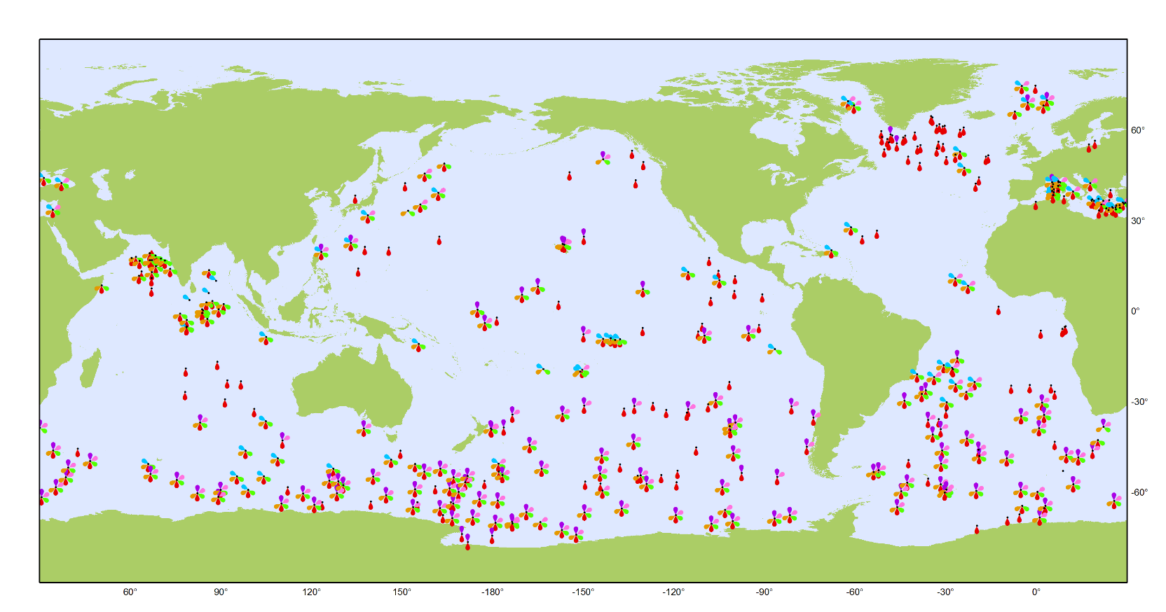
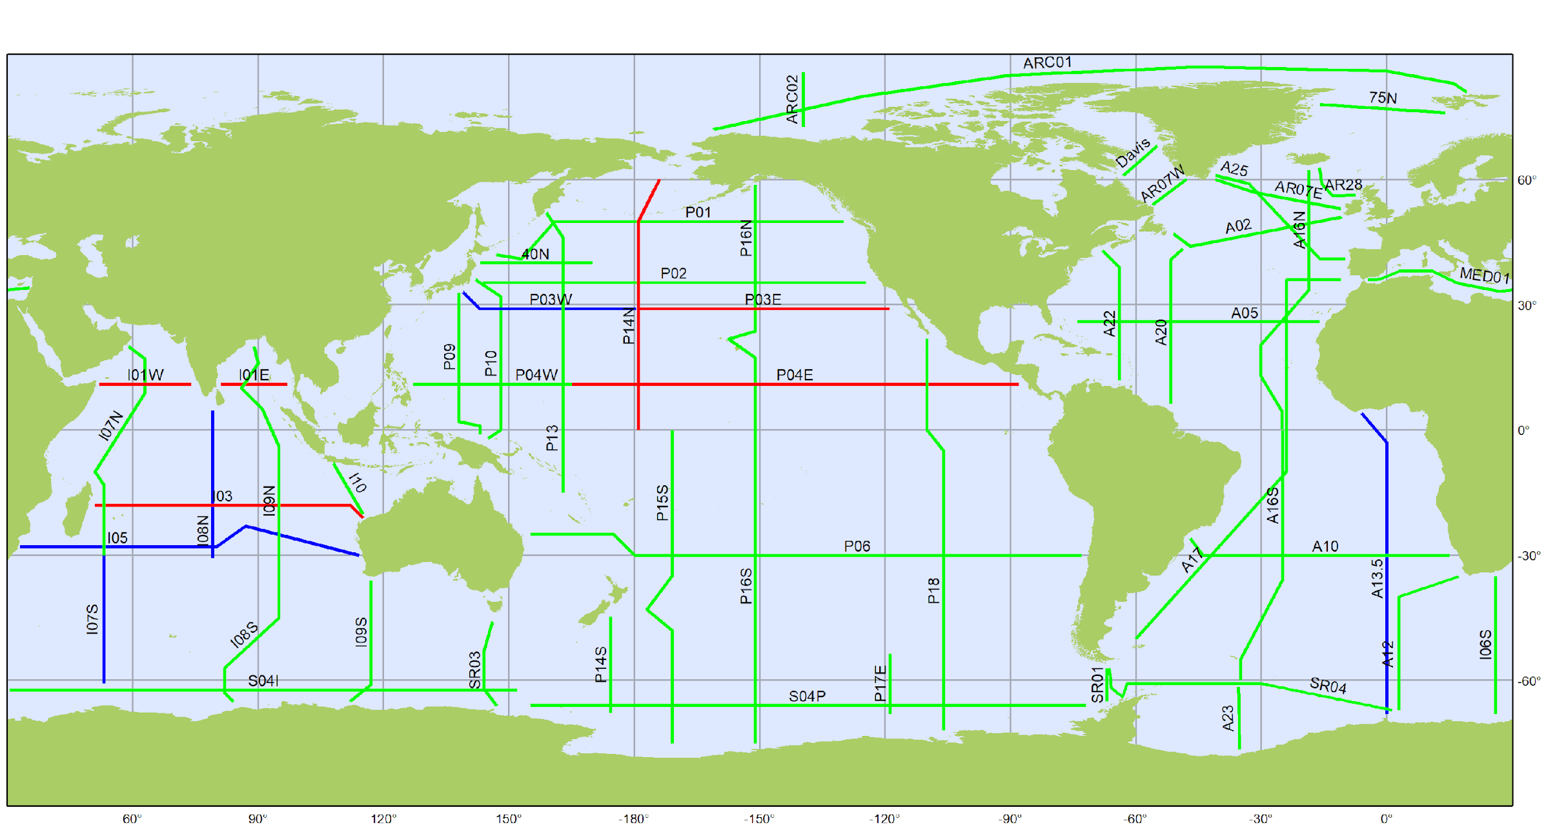



Coordination & communication services for an integrated ocean observing system
www.ioccp.org/foo
Towards a sustained global observation network for marine biogeochemistry
www.ioccp.org @ioccp_org
www.goosocean.org @GOOSocean

Slide 3

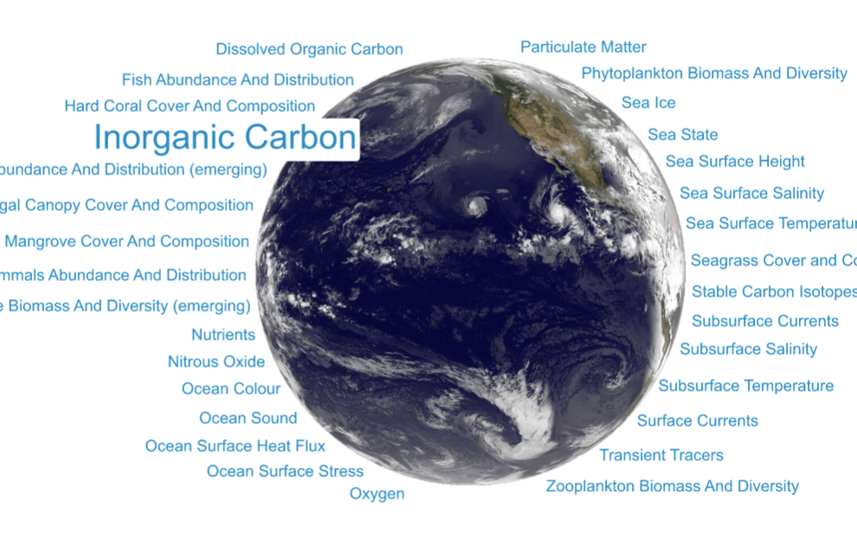
Support for global coordination of the
Integrated Marine Debris Observing System
Human Pressure Variables:
Marine (Plastic) Debris
EOVs

