Slide 2
A Taxonomy for the Global Digital Ecosystem: Intelligent Semantic Data Agents for Marine Debris Data and Internet of Data
Marine Litter/Plastic: a Global Catastrophic Risk and A Responsibility
Linking Data and Knowledge to Society
Change of Concepts
Taxonomy of the MDLE
Hans-Peter Plag & Shelley Jules-Plag
Old Dominion University
Norfolk, VA, USA

Slide 3
Marine Litter/Plastic: a Global Catastrophic Risk and A Responsibility
448 Mt in 2015
A LIFETIME OF PLASTIC
The first plastics made from fossil fuels are just over a century old.They came into widespread use after World War II and are found today in everything from cars to medical devices to food packaging. Their useful lifetime varies. Once disposed of, they break down into smaller fragments that linger for centuries.
Average usetime: 5 years
Average lifetime:
500 - 5,000 years
JASON TREAT AND RYAN WILLIAMS, NGM STAFF
SOURCE: ROLAND GEYER, UNIVERSITY OF CALIFORNIA, SANTA BARBARA
https://www.nationalgeographic.com/magazine/2018/06/plastic-planet-waste-pollution-trash-crisis/

Slide 4
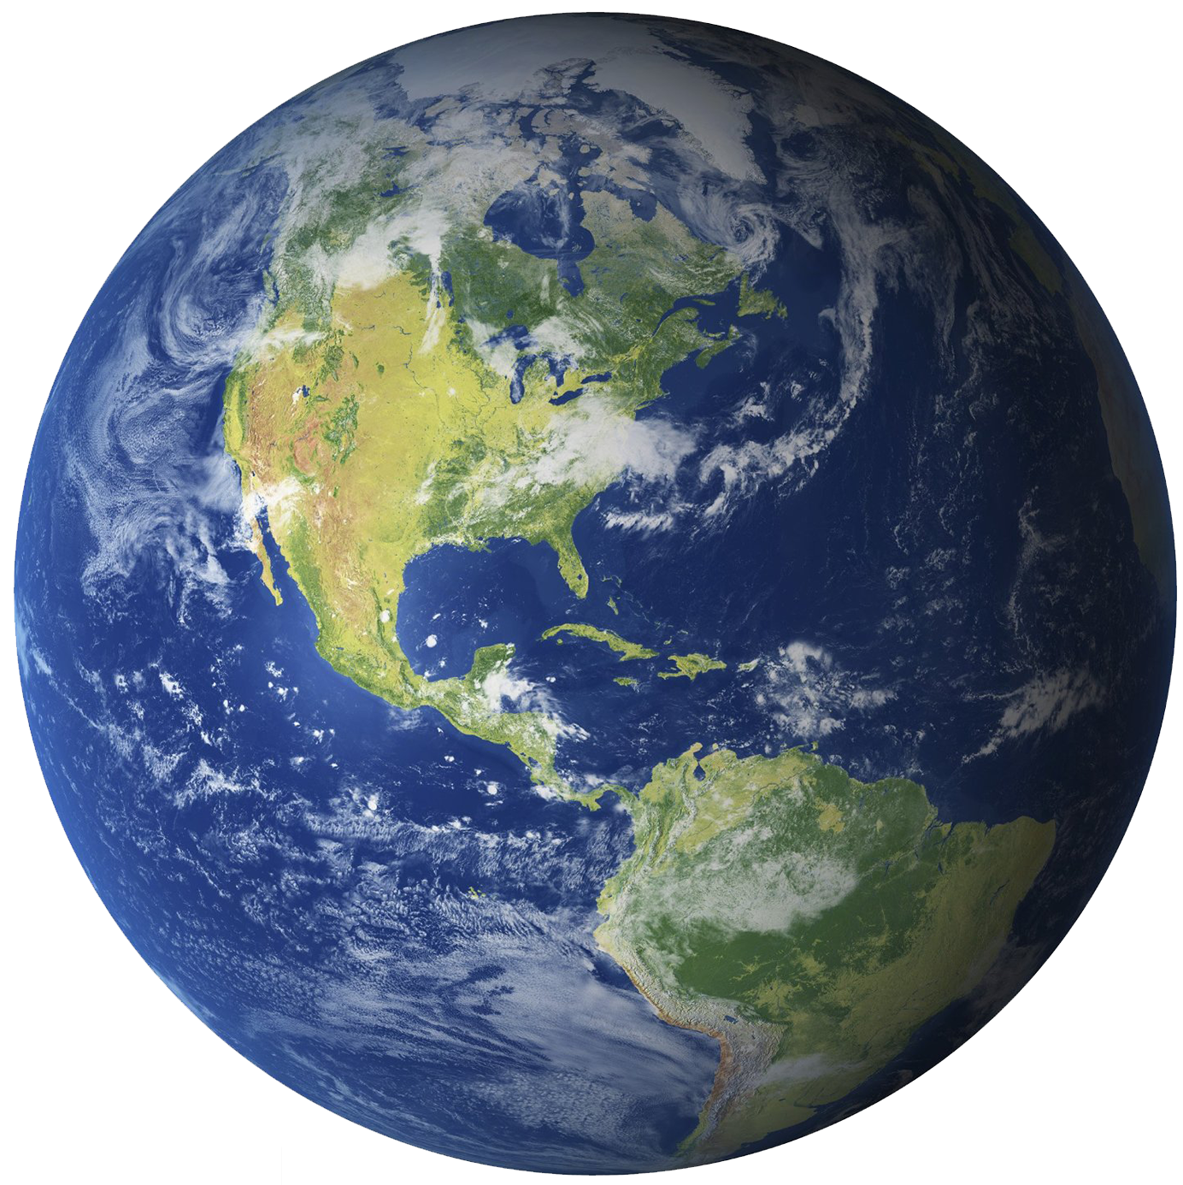
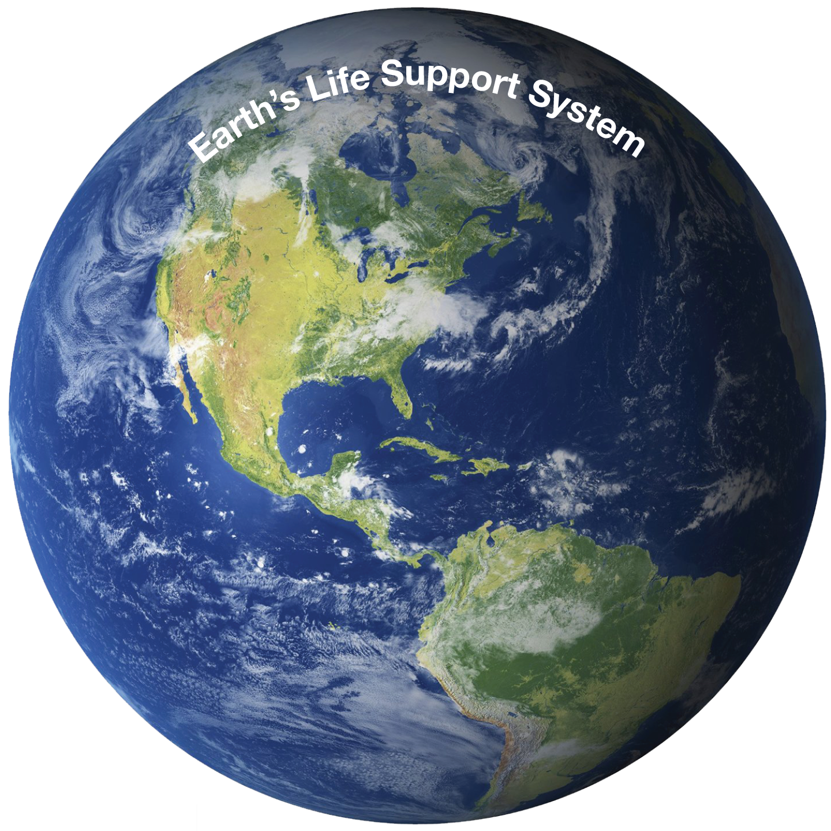
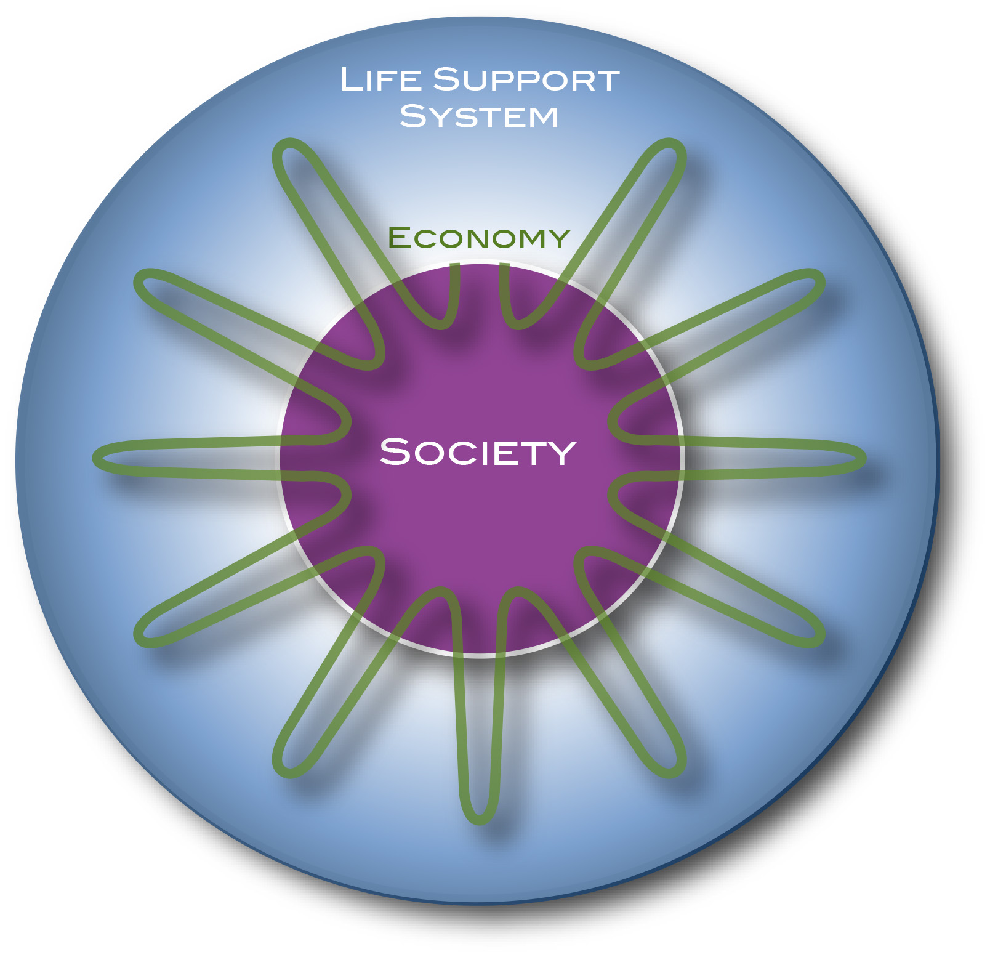
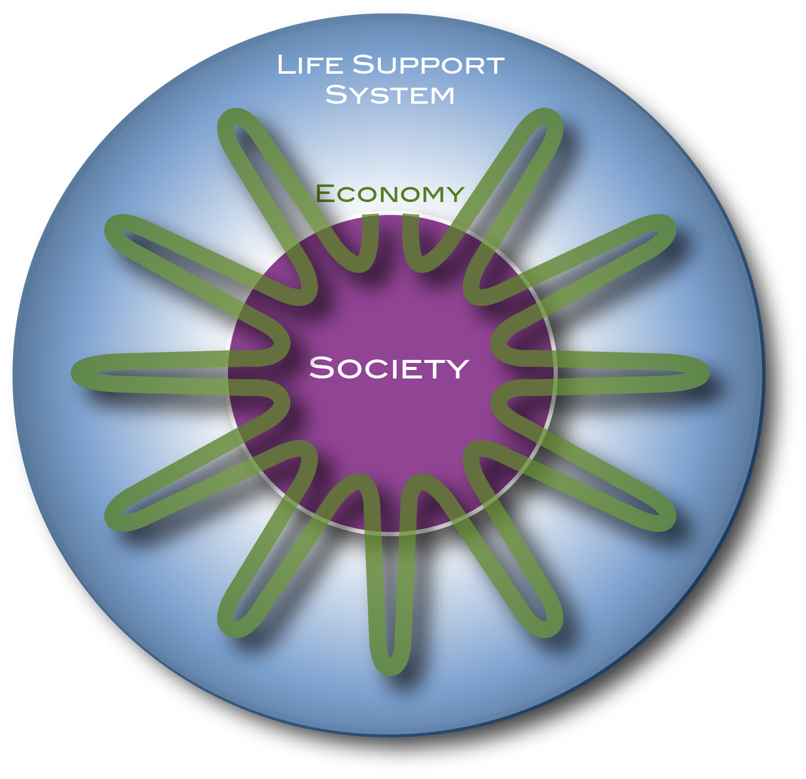
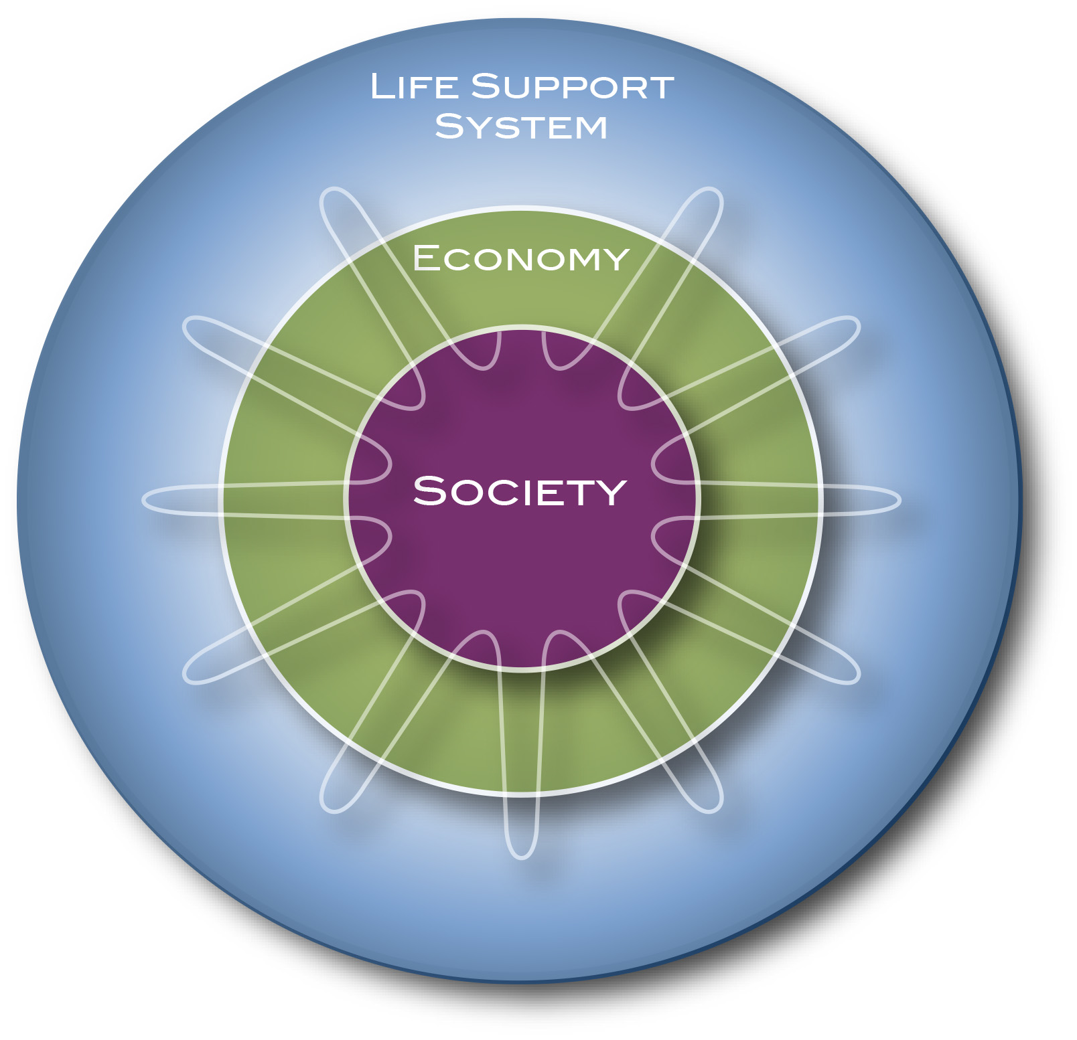
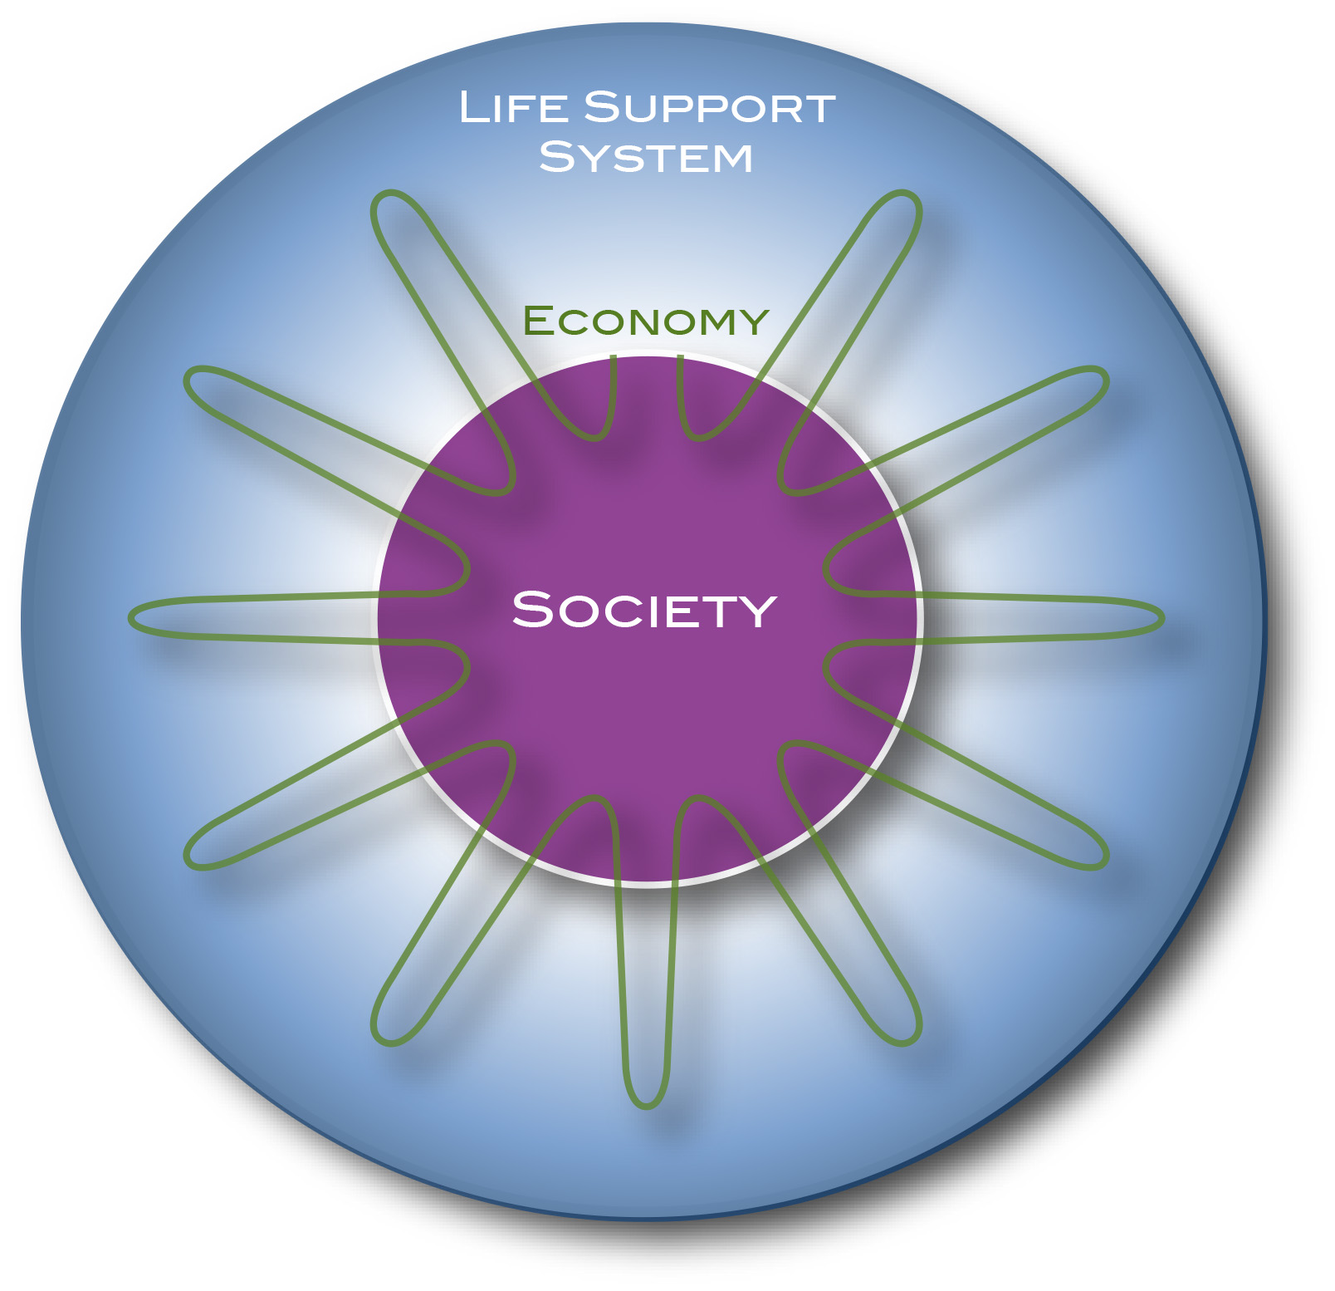
Marine Litter/Plastic: a Global Catastrophic Risk and A Responsibility
Planetary Physiology
Earth: Life-Support System for many species
Everything is about Flows
FLOWS
Flows have accelerated in the last 200 years;
exploded in the last 70 years.

Slide 5
Marine Litter/Plastic: a Global Catastrophic Risk and A Responsibility
448 Mt in 2015
2% annual increase in production:
2025: 550 Mt
2035: 670 Mt
2045: 817 Mt
Total production:
2015: 7 Bt
2045: 26 Bt
1% in the ocean: 260 Mt
In coastal built environment prone to disasters:
1.7 Bt
A LIFETIME OF PLASTIC
The first plastics made from fossil fuels are just over a century old.They came into widespread use after World War II and are found today in everything from cars to medical devices to food packaging. Their useful lifetime varies. Once disposed of, they break down into smaller fragments that linger for centuries.
}
Average usetime: 5 years
Average lifetime:
500 - 5,000 years
400 million tons (Mt)
Build.+Const.: 72 Mt, 35 yrs
Industrial mach.: 3 Mt, 20 yrs
Transportation: 30 Mt, 13 yrs
Electrical: 19 Mt, 8 yrs
Textiles: 65 Mt, 5 yrs
Consum. prod.: 46 Mt, 3 yrs
Packaging: 161 Mt, <0.5 yrs
161Mt < 6 months
JASON TREAT AND RYAN WILLIAMS, NGM STAFF
SOURCE: ROLAND GEYER, UNIVERSITY OF CALIFORNIA, SANTA BARBARA
https://www.nationalgeographic.com/magazine/2018/06/plastic-planet-waste-pollution-trash-crisis/

Slide 6
Marine Litter/Plastic: a Global Catastrophic Risk and A Responsibility
Supplemental Figure 1. (a) Percent distribution of U.S. production of plastic resins in 2014. HDPE = High Density Polyethylene; LLDPE = Linear Low Density Polyethylene; LDPE = Low Density Polyethylene; PP = Polypropylene; PS = Polystyrene; PVC = Polyvinyl Chloride; PET = Polyethylene Terephthalate. (b) Percent distribution of U.S. resin sales and captive use of thermoplastics (all materials shown in top panel except thermosets) according to major markets in 2014. Source: American Chemistry Council (2015). From
Lavender Law (2017)

Slide 7
Marine Litter/Plastic: a Global Catastrophic Risk and A Responsibility
Plastic is not handled well
https://www.theguardian.com/environment/2019/aug/17/plastic-recycling-myth-what-really-happens-your-rubbish
https://www.theguardian.com/us-news/2019/jun/21/us-plastic-recycling-landfills
https://www.theguardian.com/environment/2019/jun/17/recycling-plastic-wrong-guide

Slide 8
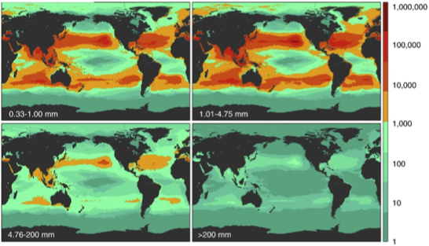
Marine Litter/Plastic: a Global Catastrophic Risk and A Responsibility

Slide 9
Marine Litter/Plastic: a Global Catastrophic Risk and A Responsibility
https://www.theguardian.com/us-news/2019/aug/12/raining-plastic-colorado-usgs-microplastics
https://pubs.usgs.gov/of/2019/1048/ofr20191048.pdf

Slide 10
Marine Litter/Plastic: a Global Catastrophic Risk and A Responsibility
The Coastal Built Environment: A Source of Current and Future Marine Debris?

Slide 11
Marine Litter/Plastic: a Global Catastrophic Risk and A Responsibility

Slide 12
Marine Litter/Plastic: a Global Catastrophic Risk and A Responsibility
Planetary Physiology
Earth: Life-Support System for many species
Everything is about Flows
FLOWS
The planetary physiology has been changed dramatically by
modern society!
Plastics in the planetary physiology will impact the 500 Billion to
1 trillions of people to come during the next 5,000 years.
Does the plastics crisis violate the rights of those not yet born?
Flows have accelerated in the last 200 years;
exploded in the last 70 years.

Slide 13
A Taxonomy for the Global Digital Ecosystem: Intelligent Semantic Data Agents for Marine Debris Data and Internet of Data
Marine Litter/Plastic: a Global Catastrophic Risk and A Responsibility
Linking Data and Knowledge to Society
Change of Concepts
Taxonomy of the MDLE
Hans-Peter Plag & Shelley Jules-Plag
Old Dominion University
Norfolk, VA, USA

Slide 14
Linking Knowledge to Action
GEO, 2005

Slide 15
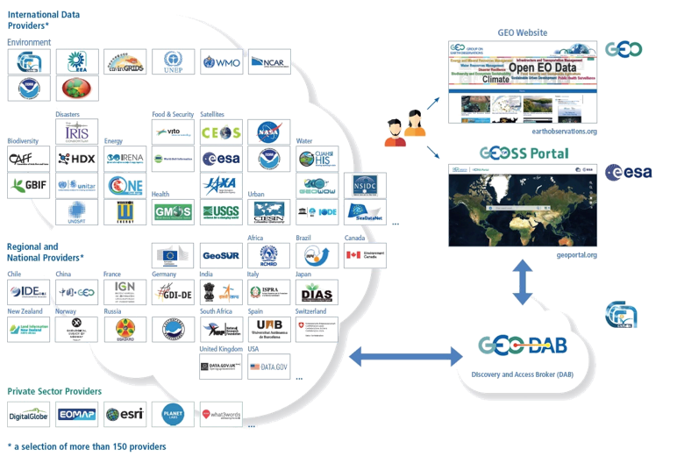
Where are the Data and Knowledge?
… see Smail et al. (2019)

Slide 16
Where are the Data and Knowledge?

Slide 17
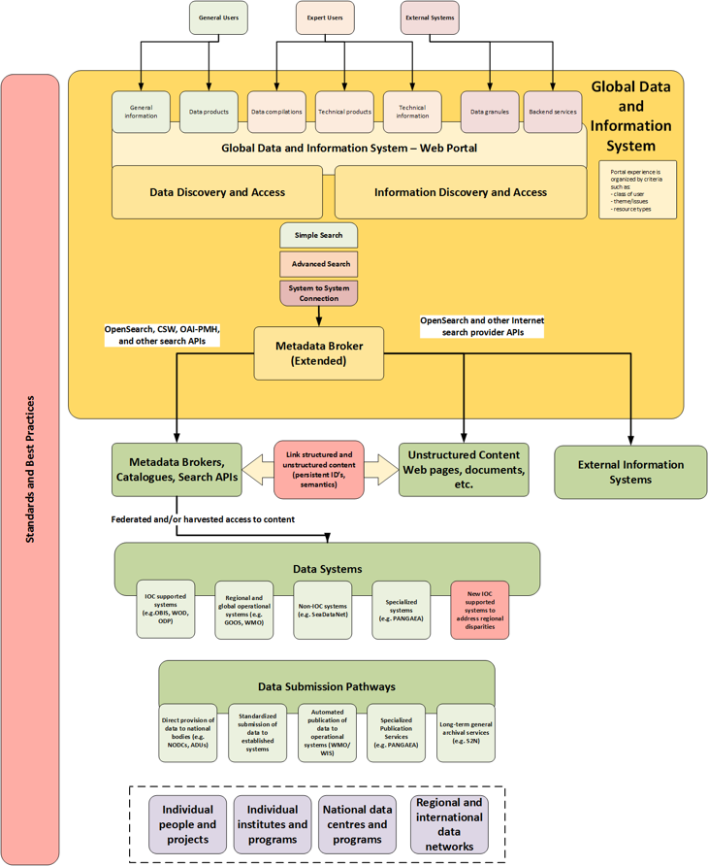
Linking Knowledge to Action
The Conceptual Architecture of ODIS (Spears et al., 2017)
… see Smail et al. (2019)

Slide 18
A Taxonomy for the Global Digital Ecosystem: Intelligent Semantic Data Agents for Marine Debris Data and Internet of Data
Marine Litter/Plastic: a Global Catastrophic Risk and A Responsibility
Linking Data and Knowledge to Society
Change of Concepts
Taxonomy of the MDLE
Hans-Peter Plag & Shelley Jules-Plag
Old Dominion University
Norfolk, VA, USA

Slide 19
Linking Knowledge to Action

Slide 20
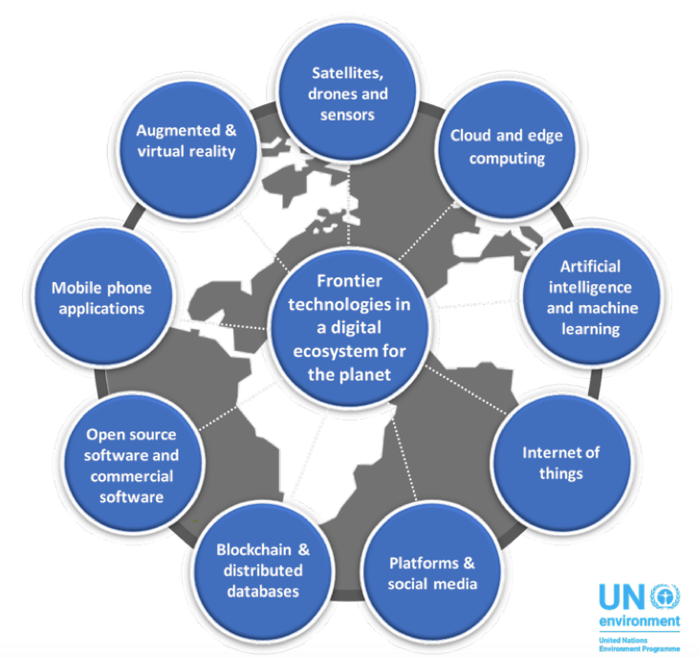
Change of Concepts
https://www.ncseglobal.org/ncse-essays/could-digital-ecosystem-environment-have-potential-save-planet

Slide 21
Change of Concepts
https://medium.com/@davidedjensen_99356/building-a-digital-ecosystem-for-the-planet-557c41225dc2

Slide 22
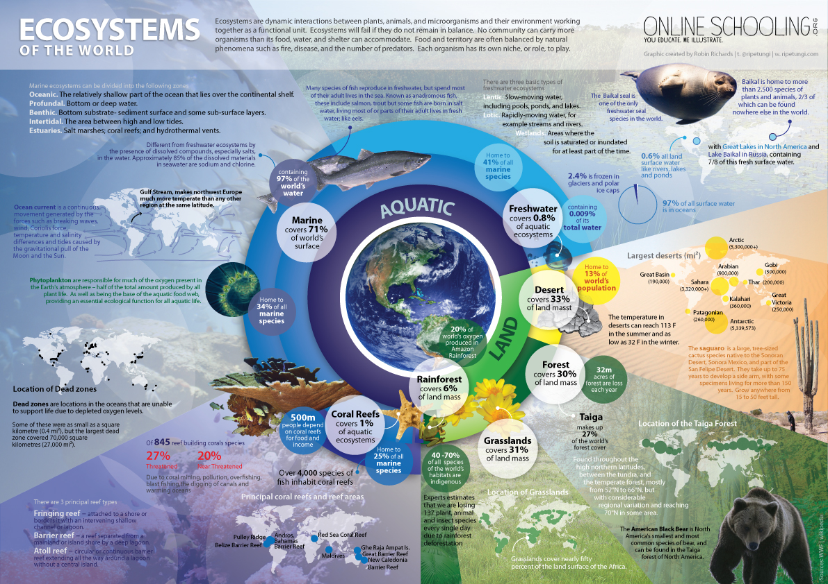
Change of Concepts
Ecosystems are dynamic interactions between plants, animals, and microorganisms and their environment working together as functional units.
What is a healthy ecosystem?

Slide 23
Change of Concepts
A Transformative Concept: From Data Being Passive Objects, to Data Being Active Subjects
Intelligent Semantic Data Agents
Plag and Jules-Plag, 2019, https://www.mdpi.com/2306-5729/4/4/135

Slide 24
Change of Concepts
From Data being passive objects, to data being active subjects
Graph Data
Plag and Jules-Plag, 2019, https://www.mdpi.com/2306-5729/4/4/135

Slide 25
Agents and Agent-Based Models
https://www.tutorialspoint.com/artificial_intelligence/artificial_intelligence_agents_and_environments.htm

Slide 26
Agents and Agent-Based Models
https://www.tutorialspoint.com/artificial_intelligence/artificial_intelligence_agents_and_environments.htm

Slide 27
Agents and Agent-Based Models
https://www.tutorialspoint.com/artificial_intelligence/artificial_intelligence_agents_and_environments.htm

Slide 28
Agents and Agent-Based Models
https://www.tutorialspoint.com/artificial_intelligence/artificial_intelligence_agents_and_environments.htm

Slide 29
Agents and Agent-Based Models
What Is An Agent?
An agent is:
a discrete entity with its own behaviors, decision making rules, and goals;
an autonomous entity, with a capability to adapt and modify its behaviors
Agents:
vary by their attributes and available accumulated resources;
Examples:
People, groups, communities, organizations;
Social insects, swarms;
Robots, systems of collaborating robots.
Decision rules vary by agent
Sophistication of rules;
Cognitive “load”;
Internal models of the external world;
Memory employed.
What is the effect of agent diversity on the system?
Do certain types of agents dominate?
Does the system evolve toward a stable mix of agent types?

Slide 30
Agents and Agent-Based Models
What Is An Agent?
+ Memory
+ Autonomy
Agent
Attributes
Rules of behavior
Memory
Sophistication
Resources

Slide 31
A Taxonomy for the Global Digital Ecosystem: Intelligent Semantic Data Agents for Marine Debris Data and Internet of Data
Marine Litter/Plastic: a Global Catastrophic Risk and A Responsibility
Linking Data and Knowledge to Society
Change of Concepts
Taxonomy of the MDLE
Hans-Peter Plag & Shelley Jules-Plag
Old Dominion University
Norfolk, VA, USA

Slide 32
Taxonomy of the Marine Litter Digital Ecosystem (MLDE)
Taxonomy:
Domains
Classes
Families
Species
Taxonomy of the MLDE includes initially these domains:
Data Collection Domain (DCD),
Data Processing Domain (DPD)
Data Representation Domain (DRD),
Tool Representation Domain (TRD),
Model Representation Domain (MRD),
Knowledge Representation Domain (KRD),
Best Practices Domain (BPD).
Each of these domains has classes that consist of a number of families.
Each family comprises a (potentially large) number species.

Slide 33
Taxonomy of the Marine Litter Digital Ecosystem (MLDE)
The domains of the MLDE:
Data Collection: digital (software) agents that collect new data and generate a flow to those species that represent data products;
Data Processing: digital agents that ingest data and generate higher level products;
Data Representation: digital agents that represent data objects and can provide information extracted from these objects, as well as, give access to the data in the objects and receive feedback on data;
Tool Representation: digital agents that give access to models and data processing tools;
Model Representation: digital agents that give access to models, model outputs and can run the models on request;
Knowledge Representatives: digital agents that represent knowledge created by interaction of human and digital agents;
Best Practices: digital agents that represent best and next practices, including their origin, use, and applicability.

Slide 34
Taxonomy of the Marine Litter Digital Ecosystem (MLDE)
Data collection domain (DCD):
Classes are defined based on the type and complexity of the “sensors” that provide the data stream or data streams to the agents:
single-variable in situ sensors;
multi-variable in situ sensors;
remote sensing scanners;
data harvesting;
crowd sourcing;
…
Individual sensors providing a stream of observations constitute the most basic species.
There is considerable diversity ranging from sensors of physical conditions (e.g., temperature, humidity, displacements) to multi-variable sensors of built environment and
Most of the agents in the DCD are reflective agents.

Slide 35
Taxonomy of the Marine Litter Digital Ecosystem (MLDE)
https://www.tutorialspoint.com/artificial_intelligence/artificial_intelligence_agents_and_environments.htm

Slide 36
Taxonomy of the Marine Litter Digital Ecosystem (MLDE)
https://www.tutorialspoint.com/artificial_intelligence/artificial_intelligence_agents_and_environments.htm

Slide 37
Taxonomy of the Marine Litter Digital Ecosystem (MLDE)
https://www.tutorialspoint.com/artificial_intelligence/artificial_intelligence_agents_and_environments.htm

Slide 38
Taxonomy of the Marine Litter Digital Ecosystem (MLDE)
https://www.tutorialspoint.com/artificial_intelligence/artificial_intelligence_agents_and_environments.htm

Slide 39
Taxonomy of the Marine Litter Digital Ecosystem (MLDE)
Learning agents:
The essential component of autonomy,
this agent is capable of learning from experience,
it has the capability of automatic information acquisition and integration into the system,
any agent designed and expected to be successful in an uncertain environment is considered to be learning agent.

Slide 40
Taxonomy of the Marine Litter Digital Ecosystem (MLDE)
Next Steps:
Activate a community;
Discuss and polish the concept and Taxonomy: White Paper
Develop a framework (similar to the HTML process);
Standards;
Pilot Project

Slide 41
Marine Litter Digital Ecosystem (MLDE)
Data collection domain (DCD):
Classes are defined based on the complexity of the “sensors” that provide the data stream or data streams
Individual sensors providing a stream of observations constitute the most basic species. There is considerable diversity ranging from sensors of physical conditions (e.g., temperature, humidity, displacements)
The agents in the DCD are often linked to sensors or provide means for the reporting of data through crowd sourcing or the harvesting of data from existing sources.
Agents in the DRD that represent data objects can represent a range of objects from collections of raw data to information extracted from data, including complex indicators for the environment or synthetic data and information based on models. If they are asked to provide information that requires data processing, these agents can interact with the agents in the TRD representing tools for processing. They would have the full information related to the data object each of them represent ranging from the actual data, the full metadata, information on quality, usability, former uses including – to the extent legally allowed – former users, processing tools, and feedback from other users.
Agents in the KRD representing knowledge have semantic capabilities to answers questions from human agents. The knowledge they represent is created in collaboration of relevant groups of societal agents, including scientists, policy makers and other relevant stakeholders.
While most of the agents in the DCD could be reflective agents, the agents in the other domains would have to be learning agents that combine model-based, goal-based and utility-based agents. In particular the agents in the DRD and LRD would need semantic capabilities.
A first implementation of the MLDE could utilize the infrastructure available through the Web. The standardized protocol for the communication between the different agents would require a major development within the framework provided by the Web.

Slide 42
Agents and Agent-Based Models
Agent Interaction
Agents have neighborhoods
Various topologies connect agents with their neighbors:
Agents can move in free (continuous) space
Cellular automata have agents interacting in local “neighborhoods”
Agents can be connected by networks of various types and be static or dynamic
Agents can move over Geographical Information Systems (GIS) tilings
Sometimes spatial interactions are not important (“Soup” Model)
Euclidean Space: 2D, 3D
Grid
Network
GIS

Slide 43
Bringing the Knowledge of Plastic Debris in the Oceans to Society
Plag, 2019: Town Hall at OCEANS 2019, Seattle
Plastics have many many advantages - can replace many other materials
Current mainstream economic model allows for production-costs only, without considering impact-costs
Production is rapidly increasing
Single/one-time use is a major fraction
There is no recycling, only down-cycling
Plastics are everywhere
Plastics are in everything
Plastics impact ecosystems and accelerate extinction
Microplastics are in all food chains
There are many time-lagged impacts: land fills, built environment, coastal infrastructure
Sea-level rise, climate change impacts (including storms, wildfires) can disperse plastics
…..
The threat is increasingly better understood …

